Slide 1

LI-FI TECHNOLOGY
15CSS86
SEMINAR
Date : 26/05/2020
Name : JAILEKHA .C
USN : 1CR16CS059
Under the guidance of:
Mrs. S. Aarthi ,
Assistant Professor
Department of Computer Science & Engineering

Slide 2
Abstract
Li-Fi stands for Light Fidelity. The technology is very new and was proposed by the German physicist Harald Haas in 2011 TED (Technology, Entertainment, Design) Global Talk on Visible Light Communication (VLC). Li-Fi is a wireless optical networking technology that uses light emitting diodes (LEDs) for transmission of data. The term Li-Fi refers to visible light communication (VLC) technology that uses light as medium to deliver high-speed communication in a manner similar to Wi-Fi.
This paper focuses on Li-Fi, its applications, features and comparison with existing technologies like Wi-Fi etc.
Li-Fi provides better bandwidth, efficiency, connectivity and security than Wi-Fi and has already achieved high speeds larger than 1 Gbps under the laboratory conditions. By leveraging the low-cost nature of LEDs and lighting units, there are lots of opportunities to exploit this medium.

Slide 3
Outline
INTRODUCTION
LITERATURE SURVEY
METHODOLOGIES USED
METHOD 1
METHOD 2
…..
RESULTS AND DISCUSSION
Critical Review
CONCLUSION
REFERENCES

Slide 4
INTRODUCTION
In the era of overcrowded (data communication) world, Li-Fi is a new way of wireless communication that uses LED lights to transmit data wirelessly. Transmission of data is one of the most important day to day activities in the fast growing world. The current wireless networks that connect us to the Internet are very slow when multiple devices are connected. Also with the increase in the number of devices which access the Internet, the availability of fixed bandwidth makes it much more difficult to enjoy high data transfer rates and to connect a secure network.
Radio waves are just a small part of the electromagnetic spectrum available for data transfer. Li-Fi has got a much broader spectrum for transmission compared to conventional methods of wireless communications that rely on radio waves.

Slide 5
INTRODUCTION
The basic ideology behind this technology is that the data can be transferred through LED light by varying light intensities faster than the human eyes can perceive.
By Communication through visible light, Li-Fi technology has the possibility to change how we access the Internet, stream videos, receive emails and much more. Security would not be an issue as data can’t be accessed in the absence of light. As a result, it can be used in high security military areas where RF communication is prone to eavesdropping.

Slide 6
LITERATURE SURVEY
Li-Fi is a VLC, visible light communication, technology developed by a team of scientists including Dr Gordon Povey, Prof. Harald Haas and Dr Mostafa Afgani at the University of Edinburgh. The term Li-Fi was coined by Prof. Haas when he amazed people by streaming high-definition video from a standard LED lamp, at TED Global in July 2011.
Li-Fi is now part of the Visible Light Communications (VLC) PAN IEEE 802.15.7 standard. “Li-Fi is typically implemented using white LED light bulbs. These devices are normally used for illumination by applying a constant current through the LED.

Slide 7
LITERATURE SURVEY
However, by fast and subtle variations of the current, the optical output can be made to vary at extremely high speeds.
Unseen by the human eye, this variation is used to carry high-speed data,” says Dr Povey, , Product Manager of the University of Edinburgh's Li-Fi Program ‘D-Light Project’.
So we have seen great leaps in the past five years. Smart phones, cloud computing and multitouch tablets etc.
These innovations change the way we live and work.
However, believe or not, we are just getting started. Technology will get even better

Slide 8
LITERATURE SURVEY
Wi-Fi can cover an entire house, school, the bandwidth is limited to 50-100 megabits per seconds (Mbps). It is a most current Internet services, but insufficient for moving large data files like HDTV movies, music libraries and video games. The most of the dependent upon ‘the cloud’ or our own ‘media services’ to store all of our files, including movies, photos, audio and video devices, games, the more and most bandwidth and speed should be needed to access this data.
Therefore RF-based technologies such as today’s Wi-Fi are not the optimal way. In addition, Wi-Fi may not be the most efficient way to provide new desired capabilities such as precision indoor positioning and gesture recognition.
The optical wireless technologies, sometimes called visible light communication (VLC), and more recently referred to as Li-Fi should be used.

Slide 9
LITERATURE SURVEY
On the other hand, offer an entirely new paradigm in wireless technologies in the terms of communication speed, usability and flexibility, reliability.
VLC is the possible solution to the global wireless spectrum shortage. technology is a fast and cheap optical version of Wi-Fi. It is a based on Visible Light Communication [12, 18].
The data is encoded in the light to generate new data stream by varying the flickering rate, to be clearer, by modulating the LED light with data signals. [4].
This is a whole new spectrum of possibilities as compared to the radio waves spectrum and is 10000 times more in size.
Visible light is not injurious to vision and are a mandatory part of an infrastructure, therefore abundantly available and easily accessible.

Slide 10
METHODOLOGIES
PROPOSED TOPIC:Let’s Talk Little bit about Wi-Fi, We all know that Wi-Fi transform the digital communication. Without this technology our mobile way of life would somewhat different. Wi-Fi currently uses 60% of all internet traffic.
With all that being said, Wi-Fi still have some issues like it get sketchy when signal get varied and it’s not totally secure because the signal can travel through walls and be easily picked up by someone else.

Slide 11
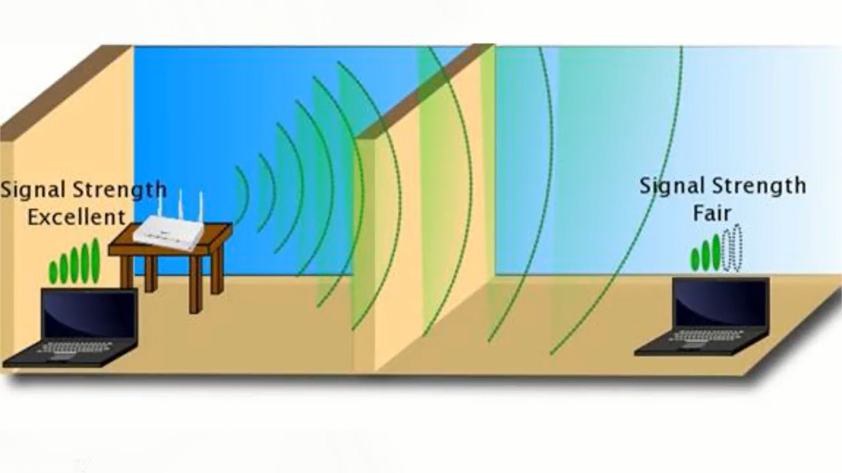
METHODOLOGIES

Slide 12
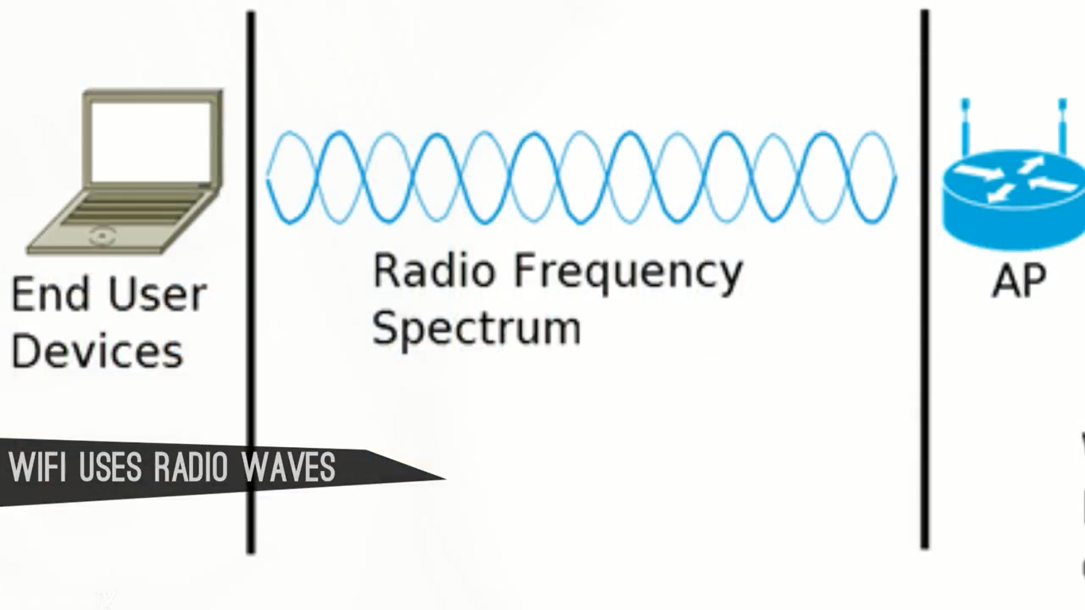
METHODOLOGIES
The main reason is that Wi-Fi uses radio waves to transfer data.

Slide 13

METHODOLOGIES
So how do improve this technology and solve these problems. We must use something which is cheap, secure and more robust for transfer the data. The answer for that is “Light”

Slide 14
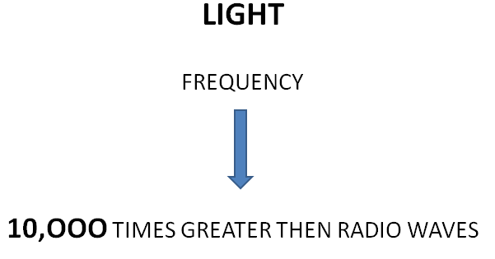
METHODOLOGIES
Light is just perfect, because it is in the electromagnetic spectrum and radio waves are also in the electromagnetic spectrum but the visible region has the high frequency.

Slide 15
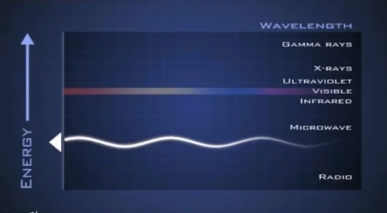
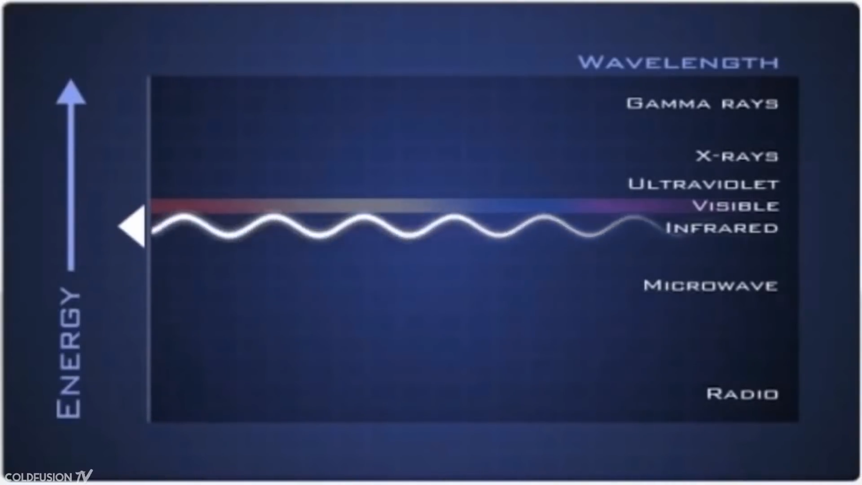
METHODOLOGIES
All this means is that light has the capacity to transfer the data at much higher speed and a very vast data in less time then the radio waves.

Slide 16
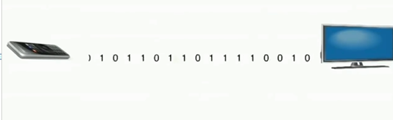
METHODOLOGIES
HOW DOES IT WORKS
So we all know about the remote control at our home have a Infra-red sersor. Basically Switching on the light, Switching off the light causes the simple and single stream of data which can transmit with a speed of 20,000 bits per second.

Slide 17
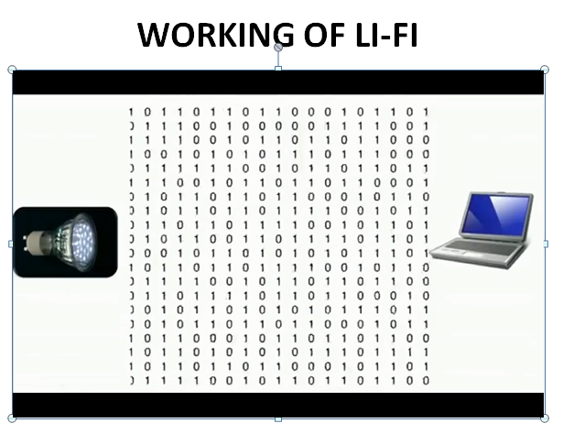
METHODOLOGIES
But in case of Li-Fi we have thousands of data streams which travels at a very high speed in parallel.

Slide 18

RESULTS AND DISCUSSION
You might we wondering if the light has to be turned on whole the time for transmission of data so how can we use this technology in the night time.
The Answer For this question is that we can dim the light down up to a level so human eye can’t detect it but the receiver can read it.
MAIN ATTRACTION IN LI-FI

Slide 19
CRITICAL REVIEW
The main motive about the li-fi technology is to enable secure wireless communications, connectivity in RF hostile environments such as petrochemical plants and hospitals.
Li-Fi also provides high speed, dense and reliable networks for enterprise environments and a pathway to enable smart buildings, transport, cities, and nations.
As mentioned above li-fi proves to be the best in coming years, but still everyone has one doubt CAN OR CANNOT IT BE HACKED?
The explanation for the above is: since light cannot pass through walls, it is thought that Li-Fi signals cannot be easily hacked.
But, Li-Fi has certain operational limitations. The light source will have to be kept on to use the network. The Li- Fi range is also smaller than the Wi-Fi range.

Slide 20
CRITICAL REVIEW
One of the biggest challenge of Li-Fi technology is it requires the line of sight.
When setup outdoors, the apparatus would need to deal with ever changing conditions.
Indoors, one would not be able to shift the receiving device. A major challenge facing Li-Fi is how the receiving device will transmit back to transmitter.
Though it has many advantages, one of the smallest disadvantage is the light can be blocked by somebody simply walking in front of LED source.
A side effect of Li-Fi is that your power cord immediately becomes your data stream. If you have power, you have internet.

Slide 21
CRITICAL REVIEW
As light is everywhere and free to use, there is a great scope for the use and evolution of Li-Fi technology. If this technology matures, each Li-Fi Bulb can be used to transmit data. As the Li-Fi technology becomes popular, it will lead to a cleaner, greener, economical, and safer communication system.

Slide 22
Conclusion
The conclusion is that, we can fit these cheap light powered internet or LI-FI everywhere and the dream of internet of things will come into reality, a situation where all the electronic devices will communicate with each other. Your phone will communicate with your fridge and the sensors at bridge will warn if there’s any damage.
If Li-Fi becomes widely available then, believe me this technology turns this world into a place where internet or transfer of information is not an obstacle.

Slide 23
Conclusion
Lastly, I would like to say that Li-Fi is not a disruptive technology that would displace Wi-Fi .
Li-Fi is complementary to Wi-Fi, in the same way as Wi-Fi is complementary to cellular network.
It can work in conjunction with existing Wi-Fi networks to provide faster and more secure internet connections.

Slide 24
References
Websites:
https://en.wikipedia.org/wiki/Wi-Fi
https://www.smh.com.au/technology/move-aside-wifi-theres-a-new-superfast- wireless-internet-coming-called-lifi-20151125-gl7j79.html
https://purelifi.com/technology/#white-paper
https://www.techworld.com/data/what-is-li-fi-everything-you-need- know-3632764/

Slide 25
REFERENCES
Journals:
Access Point Selection Scheme for Li-Fi Cellular Networks using Angle Diversity Receivers Zhihong Zeng ; Mohammad Dehghani Soltani ; Xiping Wu ; Harald Haas
Introduction to indoor networking concepts and challenges in Li-Fi
Harald Haas ; Liang Yin ; Cheng Chen ; Stefan Videv ; Damian Parol ; Enrique Poves ; Hamada
Load Balancing for Hybrid Li-Fi and Wi-Fi Networks: To Tackle User Mobility and Light-Path Blockage Xiping Wu ; Harald Haas

Slide 26
THANK YOU

